Slide 1


Babastudio

Slide 2


Envirotment Variabel
Apa itu Environment Variabel

Slide 3
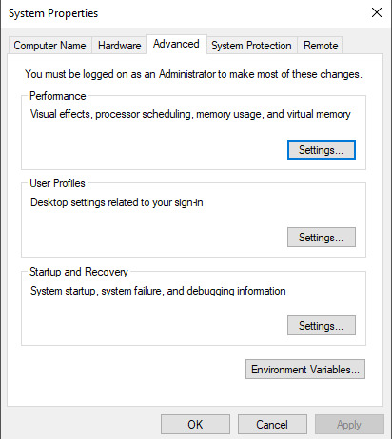

Environment Variabel

Slide 4
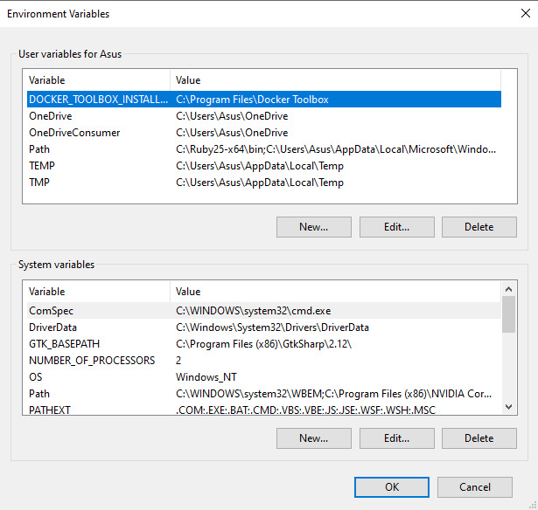
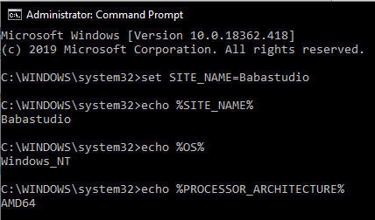
Environment Variabel

Slide 5
Envirotment Variabel
export variabel = value
echo $variabel

Slide 6

Envirotment Variabel
Buat lah latihan_env.js

Slide 7
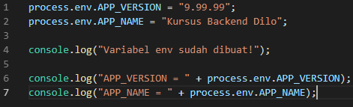
Envirotment Variabel
Buat variabel env pada nodejs

Slide 8
Envirotment Variabel
npm i --save dotenv

Slide 9
Envirotment Variabel
Buat lah .env
DB_HOST=localhost
DB_USER=dilo
DB_PASS=dilo_env
DB_NAME=blog_nodejs

Slide 10
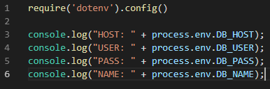
Envirotment Variabel
pada latihan_env

